Slide 1
Multivariate Discrimination LDA and PCDA
Biosystems Data Analysis
Johan Westerhuis
UNIVERSITY OF AMSTERDAM

Slide 2

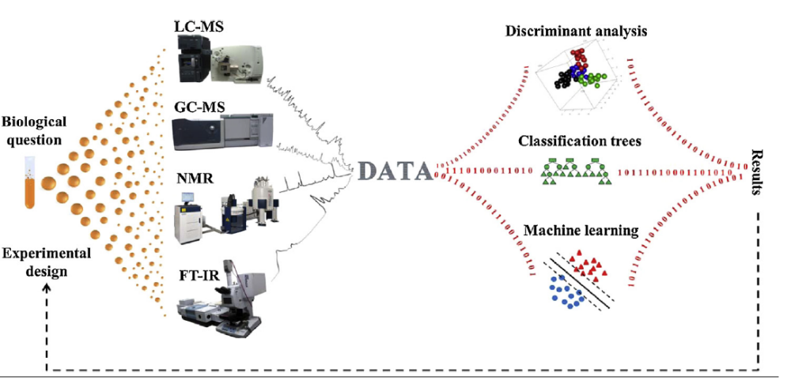
Metabolomics and partial least squares discriminant analysis (PLSDA) – a marriage of convenience or a shotgun wedding
UNIVERSITY OF AMSTERDAM
Notes:
Machine learning is a strange term here
Decide on best analytical method / data analysis method

Slide 3
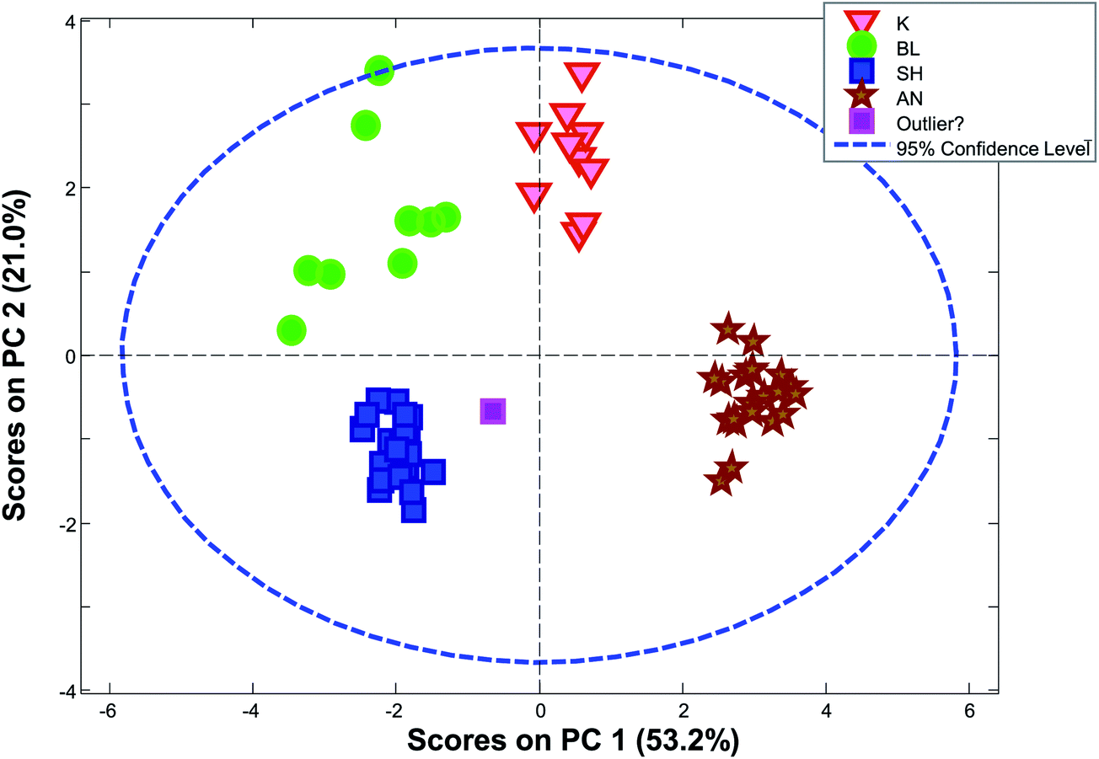
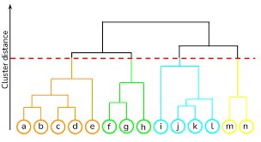

Methods
Variable (metabolites / genes)
Exploration (X)
  PCA
  Clustering
  Y information is not used in calculations, but only to color samples
Supervised analysis
  Use Y to calculate model (Y = Xb + E)
  Classification: Y defines groups: LDA and PCDA
  High dimensional ANOVA: Y defines experimental design information
  Regression: Y defines quantitative information
Machine learning for nonlinear models
  Random Forest
  Neural Nets
Validation:
  Test whether model does not overfit / effects are different from zero
Data (X)
Samples
Univariate analysis (Gene expression data)
  Comparability
  Error structure
Multivariate data analysis methods
  Gene expression and metabolomics data
Microbiome data
  Sparse and compositional data requires specific multivariate data analysis tools based on between sample distances

Slide 4
What to learn today
Many functional genomics studies aim at finding biomarkers from case control studies using supervised data analysis methods.
After todays lecture and assignment
  you understand the difference between unsupervised and supervised data analysis
  you are able to apply supervised high dimensional data analysis and you are able to interpret the results.
  you understand the differences between LDA and PCA
  you understand the differences between LDA and PCDA
UNIVERSITY OF AMSTERDAM
Notes:
Discuss pro/con
Pro: focus on prior info / feature selection
Con: overfit,

Slide 5
Discussion
What are the advantages / disadvantages of supervised analysis vs explorative analysis?
What is the difference in quantifying success between supervised vs explorative analysis?
UNIVERSITY OF AMSTERDAM
Notes:
Adv: focus , biomarkers; niet de meeste variatie
Dis: overfit , ignore other issues in data
Quantify : explained variation, between within groups / prediction error, effect size

Slide 6
supervised analysis of high dimensional data
variables
Case
Control
Explore relationship between variables that lead to GIVEN grouping of samples
  Individuals with same disease
Goals:
  Prediction model for new samples
  Selection of biomarkers
samples

Slide 7
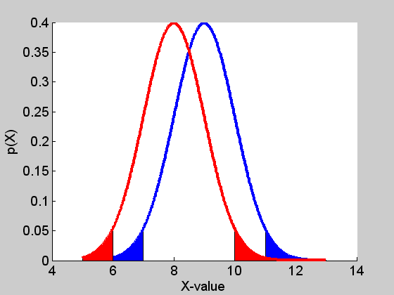
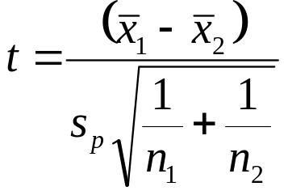
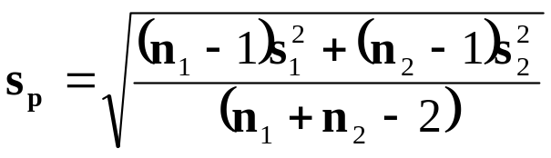
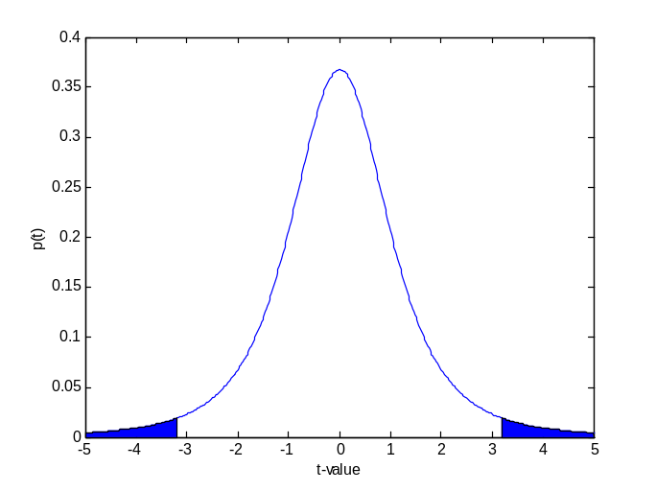
Univariate T-test for means
H0: μ₁ = μ₂
H1: μ₁ ≠ μ₂
T-test compares variation between group means to variation within groups.
T-test does not give an answer which group a sample belongs to.
UNIVERSITEIT VAN AMSTERDAM
Notes:
Distance between groups / expected variation equal to both groups

Slide 8
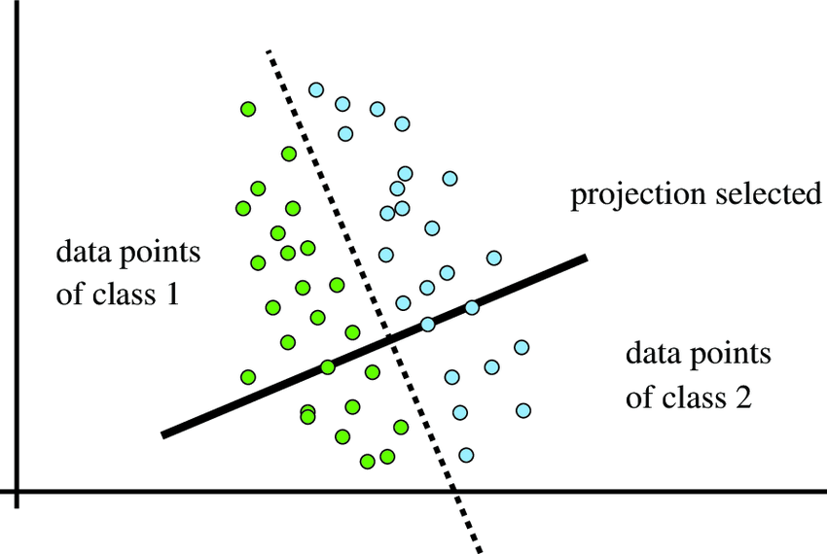
Multivariate discrimination test
Linear Discriminant Analysis
Separation line
X2
Optimal direction for discrimination
X1
UNIVERSITY OF AMSTERDAM
Notes:
LDA: multiple variables.

Slide 9
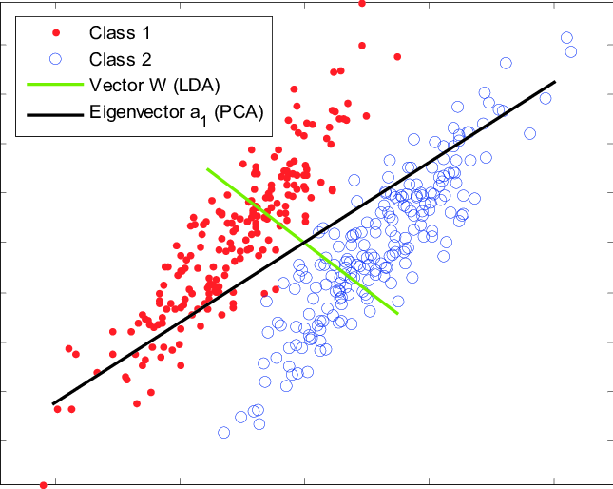
Linear Discriminant Analysis vs
Principal Component Analysis
Both PCA and LDA aim to find
a direction in multivariate space.
Such a direction can be represented by a vector in the row-space of the data matrix.
PCA aims for maximum variance.
Xa₁ provides scores with maximal variance
LDA aims for best separation.
Xd provides scores with best separation
These directions can be similar but also be very different.
d
X2
X1
UNIVERSITY OF AMSTERDAM
Notes:
Draw an example where the PCA direction = LDA direction

Slide 10

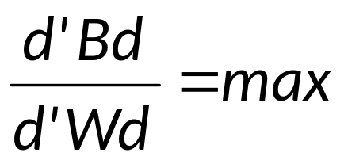

(Fisher) Multivariate
Linear Discriminant Analysis (FLDA)
LDA finds direction (d) in variable space for which the variance within the groups (W) is small while the variance between the groups (B) is large.
If 2 groups, FLDA = LDA.
d
d
B: between class covariance
W: pooled within covariance
d: discriminant vector
Notes:
Vraag naar formaat D’BD en D’WD
1xJ (JxJ) Jx1 = 1

Slide 11

Linear Multivariate Discrimination
Find vector d in R^{J} such that T = Xd maximizes
between group separation / within group separation
T = Xd
d
x₂
R^{J}
x₂
R^{I}
x_{J}
J
x_{I}
x₃
x₃
X
X
T
I
x₁
x₁
d
d = direction of line
T = position of projection of samples on that line

Slide 12
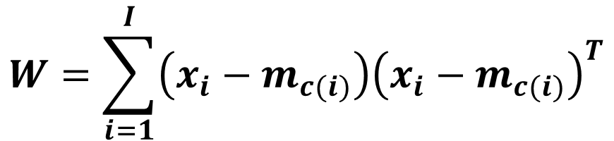
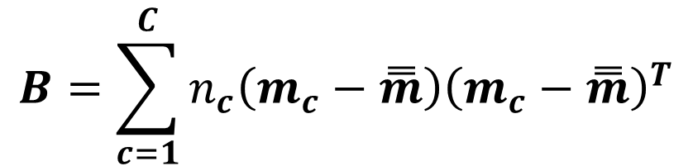
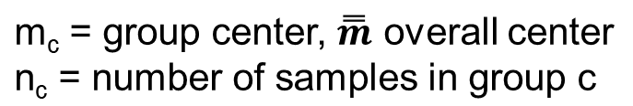
Within and Between group covariance
x_{i} = datapoint i; m_{c(i)} groupcenter for x_{i}
I = #datapoints
C: number of groups
UNIVERSITY OF AMSTERDAM
Notes:
Uitschrijven size of W, size of B
What does it contain?

Slide 13
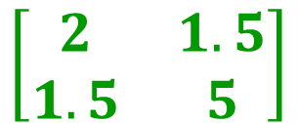
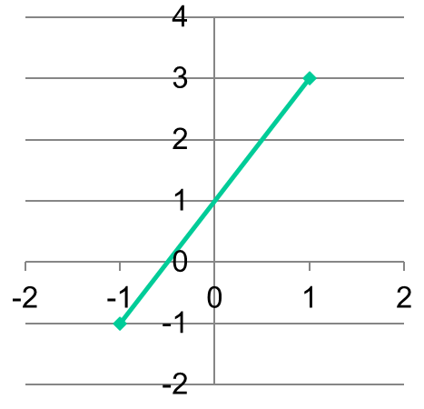
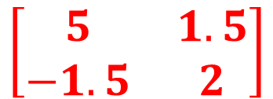
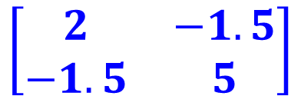
Equal within covariance structure
A
What is the within group covariance matrix for this situation?
UNIVERSITY OF AMSTERDAM
Notes:
Estimate: A: [2 .8/.8 5]

Slide 14
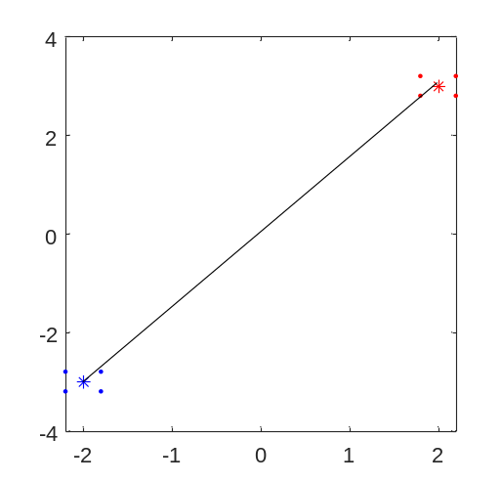
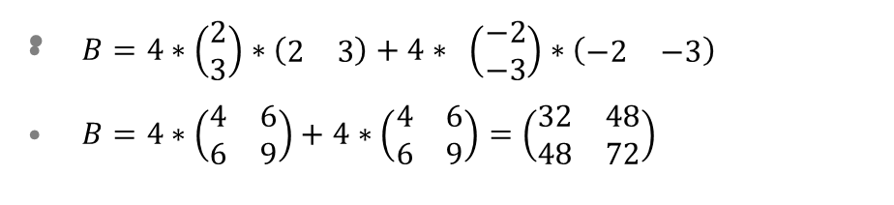



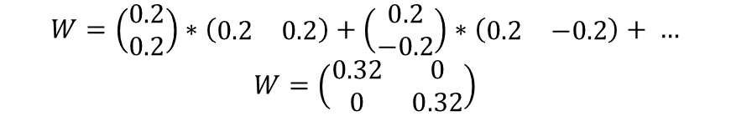
EXAMPLE
d2
d1
2.2 3.2
2.2 2.8
1.8 3.2
1.8 2.8
-2.2 -3.2
-2.2 -2.8
-1.8 -3.2
-1.8 -2.8
2 3
2 3
2 3
2 3
-2 -3
-2 -3
-2 -3
-2 -3
0.2 0.2
0.2 -0.2
-0.2 0.2
-0.2 -0.2
-0.2 -0.2
-0.2 0.2
0.2 -0.2
0.2 0.2
X
m_{c}
X-m_{c}
UNIVERSITY OF AMSTERDAM
Notes:
Pooled within variance want alle punten

Slide 15
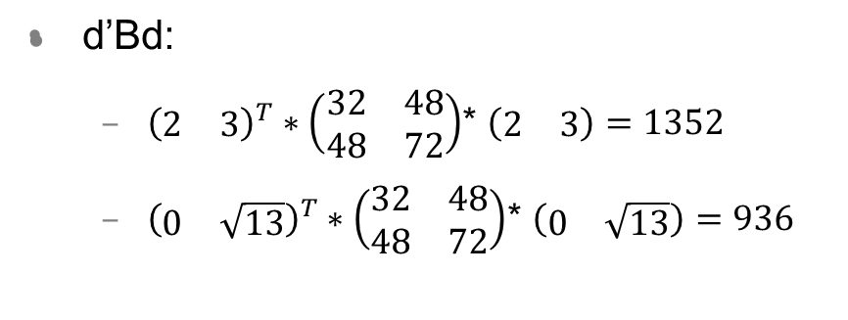
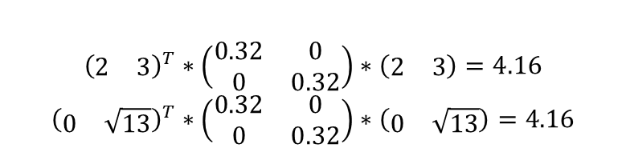
EXAMPLE
d1 = [2 3] is a better direction for separation than d2 = [0 sqrt(13)].
Sqrt(13) was used to have equal length for d1 and d2.
d affects d’Bd due to the preferred direction wrt overall center.
d in this example does not affect d’Wd as points are perfectly symmetric around their cluster center.
Ratio d’Bd / d’Wd is favorable for d1.
d1
d2
d’Wd
d1
d2
UNIVERSITY OF AMSTERDAM

Slide 16



Singular value decomposition on any X
s₁
v₁^{T}
s₂
v₂^{T}
s₃
v₃^{T}
J
X
=
+
+
I
u₁
u₂
u₃
Eigenvalue decomposition on square X
d₁^{T}
d₂^{T}
d₃^{T}
J
+
+
X
=
J
d₁
d₂
d₃

Slide 17
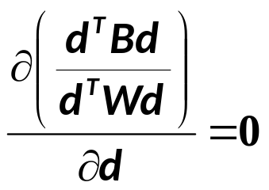
Solving the LDA equation
Differentiating with respect to d, setting equal to zero, and rearranging gives
  This can be solved as an eigenvalue problem: λd = (W⁻¹B)d
  Divide variation between groups over variation within group (similar to t-test).
  Here, λ is the eigenvalue and d the eigenvector.
scalar
scalar
scalar
(d^{T}Wdd^{T}Wd )⁻¹[(d^{T}Wd)Bd - (d^{T}Bd)Wd] = 0
c₁Bd – c₂Wd = 0
λWd = Bd
d ∝ eig(W⁻¹B)
d₀ = -0.5*(m₁ + m₂)*d
d₀ is intercept if mean of all data is not 0
UNIVERSITY OF AMSTERDAM
Notes:
Dit is: Noemer*Afgeleide teller – Teller*Afgeleide noemer / noemer^2
Denominator * derivative numerator – numerator * derivative denominator / denominator ^2
d0 = 0 if data is centered

Slide 18
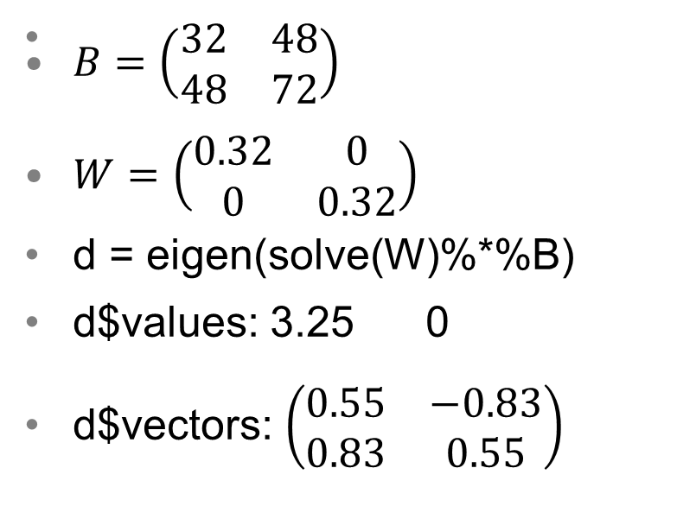
EXAMPLE
d ∝ eig(W⁻¹B),
Only 1 eigenvalue unequal to 0.
Only 1 discrimination line needed to separate two groups.
UNIVERSITY OF AMSTERDAM
Notes:
2 groups, only 1 eigenvalue; 3 groups gives two eigenvalues….
Only look at vector that belongs to nonzero eigenvalue
Direction is the same [2,3], value is slightly different: normalize

Slide 19
LDA model for New data
c_{new} = d₀ + d₁X_{new1} + d₂X_{new2} + ..
c_{new} = X_{new}*d + d₀
When c_{new} > 0 group 1, else group 2

Slide 20
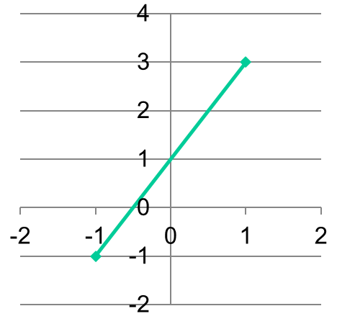
Example
M1 = [ 1 3] W = W⁻¹ = 1 0
M2 = [-1 -1] 0 1
d = W⁻¹([1 3] – [-1 -1]) = [2 4]
d0 = -0.5 * (M1+M2) * d^{T}
d0 = -0.5 * [0 2]*[2 4]^{T} = -4
VB data:
[0 0]: c = -4+[0 0]*[2 4]^{T}= -4
[0 1]: c = -4+[0 1]*[2 4]^{T}= 0
[0 2]: c = -4+[0 2]*[2 4]^{T}= 4
UNIVERSITY OF AMSTERDAM
Notes:
Explain W and W inverse

Slide 21
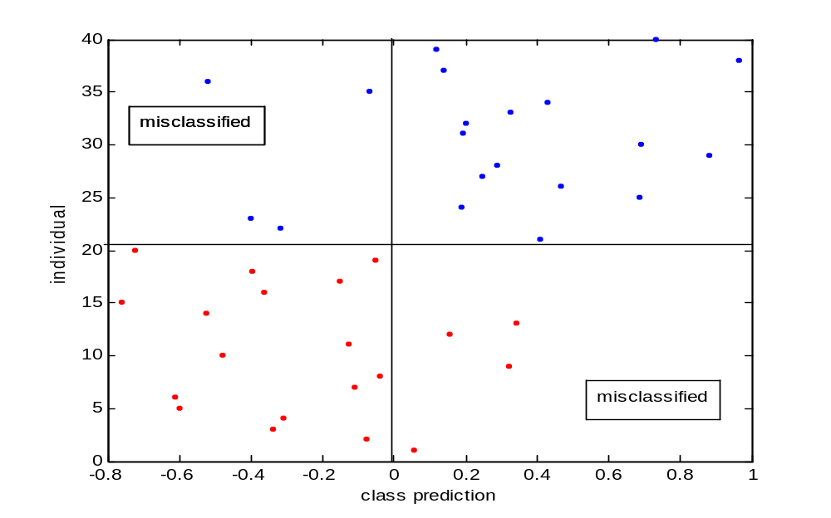
Class predictions

Slide 22
Confusion table
 |  | True Condition (determined by "Gold standard")
 |  | Positive | Negative
Test out come | Positive | True Positive | False Positive (Type I error, P-value)
 | Negative | False Negative (Type II error) | True Negative
 |  | Recall/Sensitivity TPR=TP/(TP+FN) | Specificity TNR=TN/(TN+FP)

Slide 23
LDA and biomarkers
x₂
d_{x1} and d_{x2} are equally large in discriminating direction: they have equal discriminative power.
Together x₁ and x₂ function as a biomarker.
x₁
x₂
d_{x1} is larger than d_{x2} in the discriminative direction: x₁ has more discriminative power. x₁ might be a good biomarker.
x₁

Slide 24
Summary LDA introduction
Multivariate discrimination takes relationship between variables into account.
LDA is a multivariate extension of t-test.
The ratio between group distance / within group variation is maximized to find optimal discrimination vector.
Type I and Type II errors, sensitivity, specificity etc can be used to quantify the quality of the discrimination.
UNIVERSITY OF AMSTERDAM

Slide 25
(M)univariate or Multivariate
What are the differences between performing
A Munivariate (many univariate t-tests)
A Multivariate discrimination (LDA)
UNIVERSITY OF AMSTERDAM
Notes:
Gewoon in de groep vragen:
Ieder even overleggen met buurman en 3 key zaken opschrijven.
Dan 3 groepjes polsen en resultaten op bord schrijven
Multiple testing, multivariate effects, one model vs many models
Think of prediction for new individual

Slide 26
From multivariate to high dimensional discrimination
In our problem there are few samples and many variables: LDA breaks down because W is singular.
d ∝ eig(W⁻¹B)

Slide 27
Multivariate discrimination
X3
One solution for
discriminating the
two groups
X2
X1

Slide 28
High dimensional discrimination
X3
Many solutions for
discriminating the
two groups
X2
Curse of dimensionality
X1

Slide 29
Summary high dimensional
In high dimensional data (variables > samples), W cannot be inverted. LDA cannot be used.
Use PCA to reduce # variables
Perform LDA on scores
UNIVERSITY OF AMSTERDAM

Slide 30
PCA
LDA on scores
X = TP^{T}
T = XP
class = d^{pcda}₁t₁ + d^{pcda}₂t₂
class = Td^{pcda}
class = XPd^{pcda}
class = Xr^{pcda}
=
=
=
=
XP = TP^{T}P (P^{T}P) = I
XP = T
=

Slide 31
PCDA and biomarkers
PC₂
PC₁ and PC₂ are equally large in discriminating direction: they have equal discriminative power.
Together PC₁ and PC₂ function as a biomarker.
PC₁
r_{pcda} = P * d_{pcda}
loading * discriminant vector

Slide 32
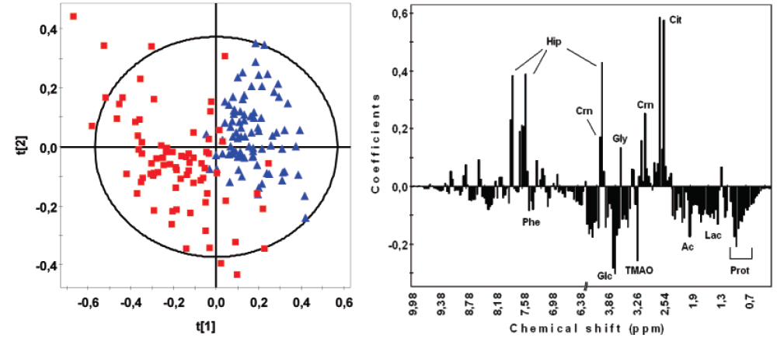
PCDA results
score plot
r_{pcda} = discrimination coefficient
d^{pca}
r^{pcda} = P*d^{pcda}
UNIVERSITY OF AMSTERDAM
Notes:
Uitschrijven P*d

Slide 33
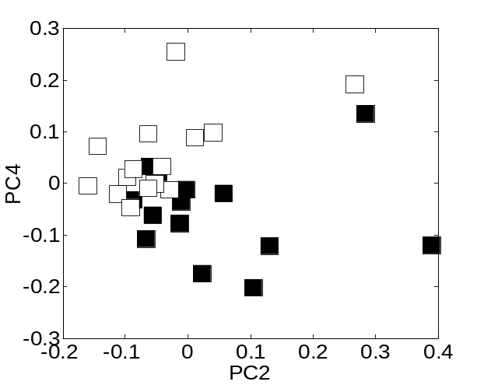
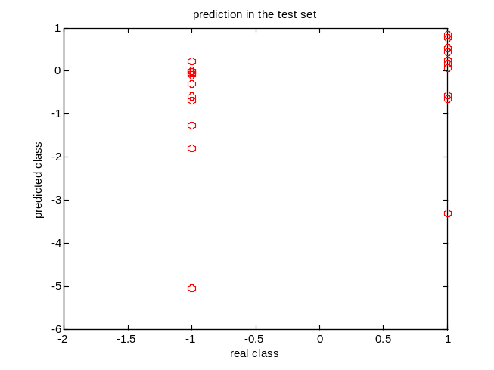
PCDA: serving two goals
PCA Model of data X=TP’
  Is the data (samples / variables) well described
  Clustering / outliers etc
  Do new samples fit the model of the data
Discrimination model between scores and class (c = Td^{pcda})
  Can the response be predicted well?
  What is the prediction error?
Predicted class
True class
UNIVERSITY OF AMSTERDAM

Slide 34
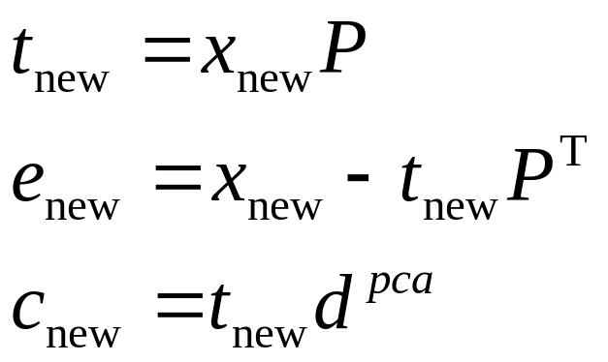
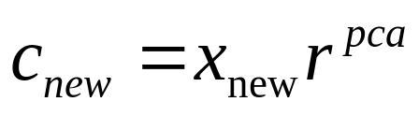
PCDA: New data
For new data: x_{new}
Or direct prediction:
Check if x_{new} fits data,
By checking if t_{new} and e_{new} are within limits
UNIVERSITY OF AMSTERDAM

Slide 35
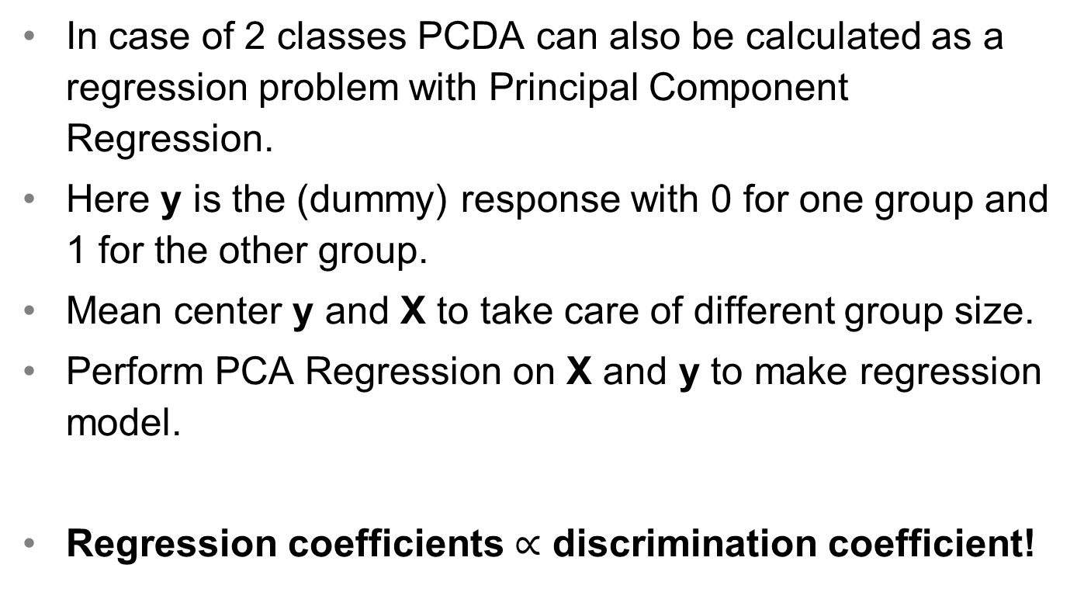
PCDA as PCA Regression
UNIVERSITY OF AMSTERDAM

Slide 36
Centering and scaling
Issues of centering and scaling as explained in PCA also apply to PCDA
Center X to focus on between sample variation.
Scale X to correct for difference in scale of the variables.
UNIVERSITY OF AMSTERDAM

Slide 37
Model complexity
(how many PCDA components)
Too few components: Not all information in data is used for prediction
Too many components: Noise (unwanted variation) is included in model leading to bad prediction
How many PCDA components to use for best model?
  Lowest prediction error for validation samples
  Cross validation
SILS / BDA

Slide 38

Cross-validation in calibration
Remove subset of the data - test set.
X
y
••••••••••
•
•
•
•
•
•
•
•
•
•
•
•
•
•
•
•
•
•
•
•
••••••••••••
••••••
••••••
••••••
••••••
••••••
••••••
••••••
••••••
•
•
•
•
•
•
•
•
•
•
••••••
••••••
••••••
••••••
••••••
••••••
••••••
••••••
••••••
••••••
••••••
••••••
••••••
••••••
••••••
••••••
••••••
••••••
••••••
••••••
••••••
••••••
••••••
••••••
••••••
••••••
••••••
••••••
••••••
••••••
Build model on remaining data - training set.
Project test set onto model – predict response for left out sample.
X
Repeat for next test set.
••
••••••••••
••••••••••••
••••••
••••••
••••••
••••••
••••••
••••••
••••••
••••••
•
••••••••••••
••••••
Repeat for R = 1,2,3...
SILS / BDA

Slide 39
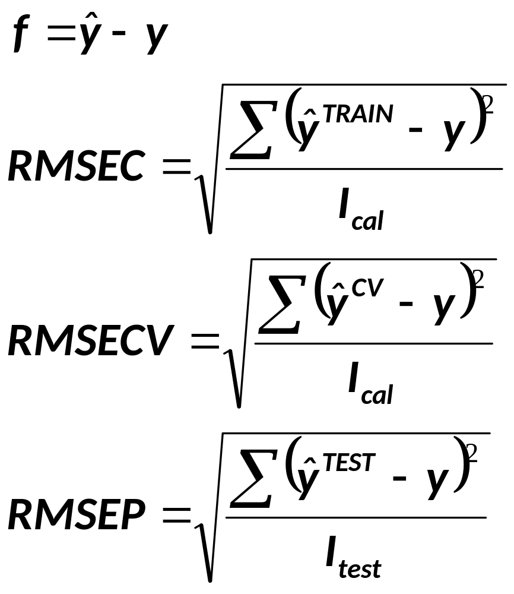

Prediction of
Using training set samples
Root mean squared error of calibration
Using cross validation
Root mean squared error of
Cross validation
Using test set samples
Root mean squared error of prediction
UNIVERSITY OF AMSTERDAM

Slide 40
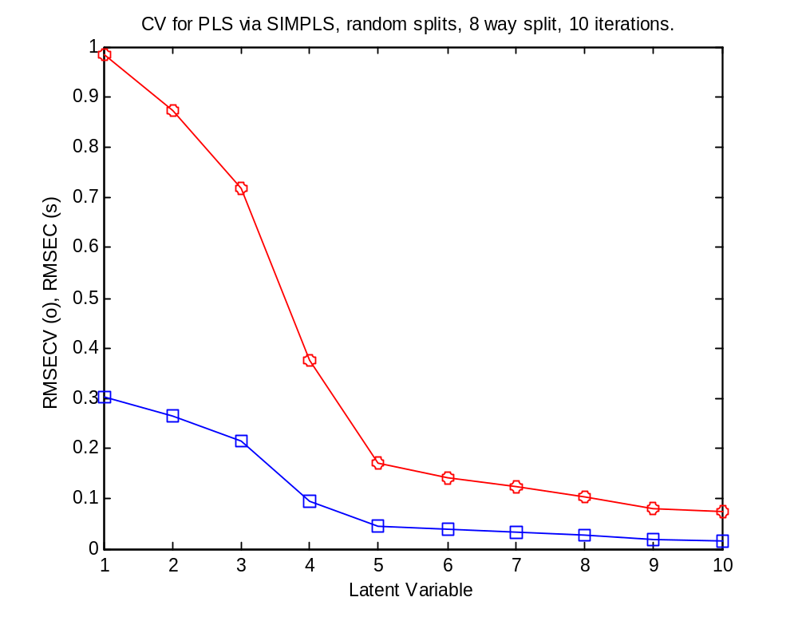
Cross validation
RMSEC and RMSECV
5 PC’s selected
More PC’s does not greatly
improve prediction much
SILS / BDA

Slide 41
Summary
PCDA (PCR) can be used for discrimination (of two groups) in case of high dimensional data.
Scaling issues important just as in PCA.
Crossvalidation can be used to estimate number of components for optimal class prediction.
Univariate biomarkers are different from multivariate biomarkers
Multivariate biomarkers cannot be validated by looking in a univariate manner to the data.
UNIVERSITY OF AMSTERDAM

Slide 42
QUESTIONS
Explain differences between LDA and PCA
Explain the differences between LDA and PCDA.
Explain how the most important features in a high dimensional discrimination problem can be obtained.
Explain the covariance matrix!
UNIVERSITY OF AMSTERDAM
Notes:
A: 1: T-tests, or 2: multivariate discrimination (PCDA)
In 1: significant tests provide important features
In 2: use LDA or PCDA discrimination coefficients

